Slide 1
Compositional Testing of S1AP protocol in Cellular Communication Networks
Prasanth Prahladan and Taeho Kim

Slide 2
Motivation
Formal specification and testing of QUIC paper
verify a complex stateful internet-protocol QUIC using the IVy tool
Goal
extend the application of the formal verification of Internet-protocols to the domain of cellular communication networks
prove a formal specification of the S1AP protocol using the IVy tool

Slide 3
Challenges
Cellular networks are closed system - not readily accessible
SCTP protocol implementation
Serializer/Deserializer implementation
Patterns of inter-protocol communication - diverse and complex
Multiple types and messages definition
Test codes for S1AP

Slide 4
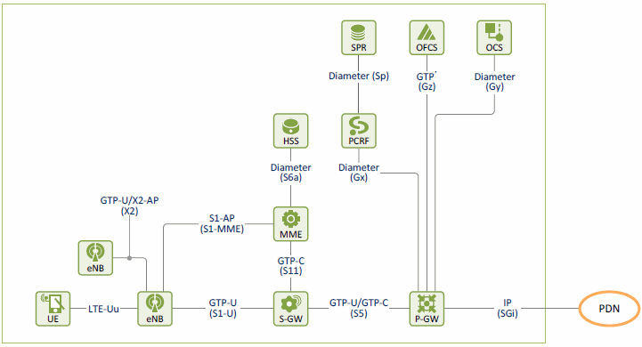
LTE network architecture

Slide 5
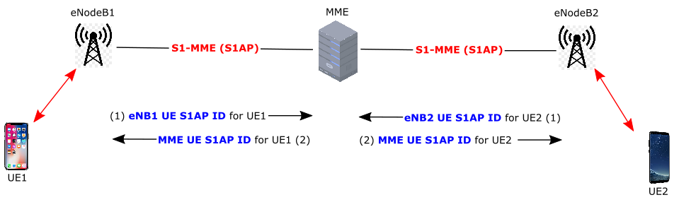
S1AP protocol

Slide 6
Why do we need formal specifications?
Knowledge implicit in implementations
Any implementation, is one realization of the protocol. It might only capture a subset of the behaviours permitted by the protocol.
Actual protocol-compliance is never tested.
𝝋1
Protocol
𝝋
𝝋2
What does it mean to specify a protocol? 1. Behaviours of the protocol, based on what’s observable ( on the wire )
2. Behaviours of the protocol, based on what we expect happens internal to each constituent sub-system.
3. Properties of the system: Safety, Liveness
𝝋3
De-facto standard: Implementations in the wild!

Slide 7
Entity representation within Ivy
Features:
Comopositional
No FSM assumption
Global Protocol specification based on “Observables”.
Generation of testing input: Automated Test-Generation
Via constraint solving
Checkers of outputs of processes
Protocol State
Actions / Events
Env.
Client
Server
channel
Our current focus

Slide 8
Method-1
Method-2
Compositional Testing
Client
Server
Application Layer(S1AP)
Ivy based verification
Protocol specification Client (eNB)
Implementation (Test-target)
( MME )
Transport Layer(SCTP)
SCTP - socket integration (Ivy + C++ )
Network Layer(IP)
Serializer/Deserializer
Device Layer

Slide 9
Protocol Message Architecture
UE-Attach
“Elementary Procedures(EP)” of a Procedure
Procedures of S1AP Protocol
UE-Migrate
“Information Elements”(IE) of an EP
…………………….
….
Components of an IE
UE-Detach
Packet
Frame

Slide 10
Constructing Serializer/Deserializer
No instantiations of structures supported.
Verified (De)Serializer!
RFC
C / F*
Most versatile in terms of flexibility of language and features. Has support for Transport Layer of stack.
QuackyDucky
(Microsoft)
Serializer/Deserializer
Thrift
Apache Thrift (Facebook/Uber)
mutli-lingual
No uint8.
Doesn’t support Ordering of message sub-structures.
proto
Protobuf (Google)
mutli-lingual
Transport Layer(SCTP)
Network Layer(IP)
C++
ASN.1
ASN1Compiler
Device Layer

Slide 11
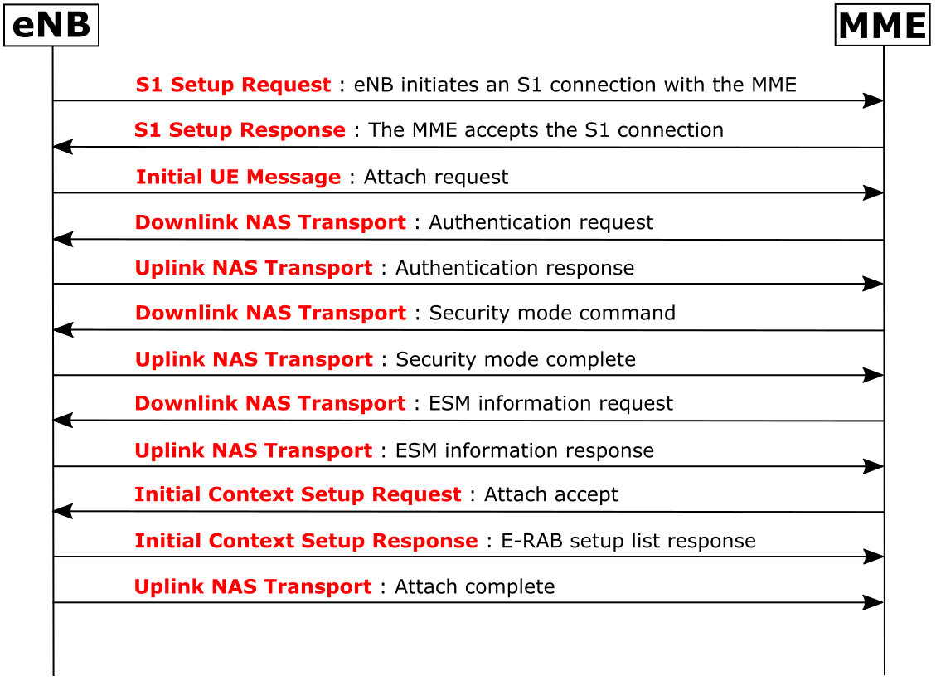
Initial UE attach procedure
S1 Setup message
Initial UE message
Downlink NAS Transport message
Uplink NAS Transport message
Initial Context Setup message

Slide 12

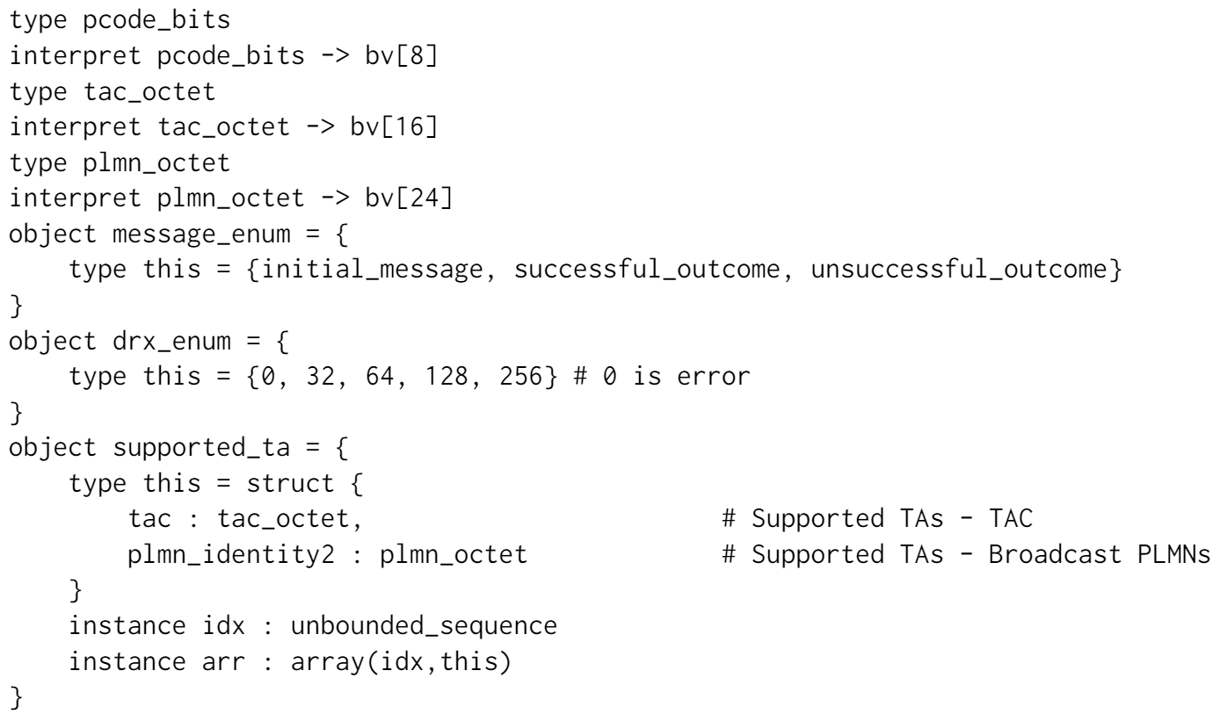
Type definition
As an example, we’ll look at the types of IEs for the S1 Setup message
Packet state
Procedure code
Tracking area code
Public land mobile network
Type of message
Discontinuous reception
Supported tracking area array

Slide 13
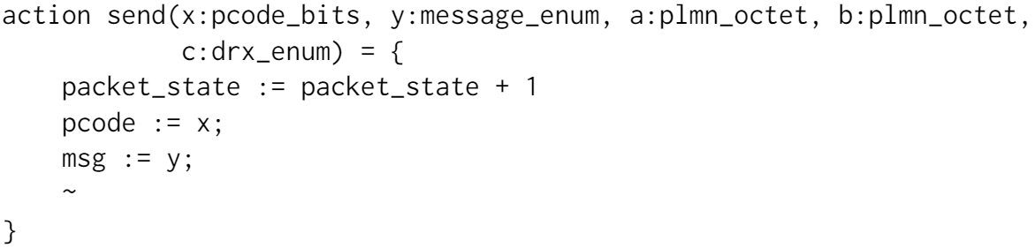
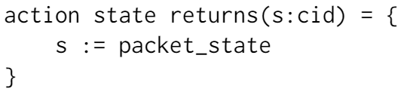
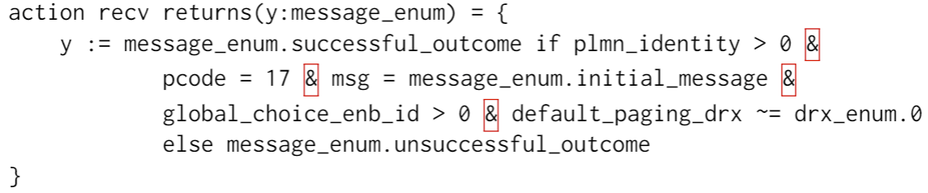
Protocol state and Mandatory IEs
Protocol state transition by action event
Checking the values of mandatory IEs

Slide 14
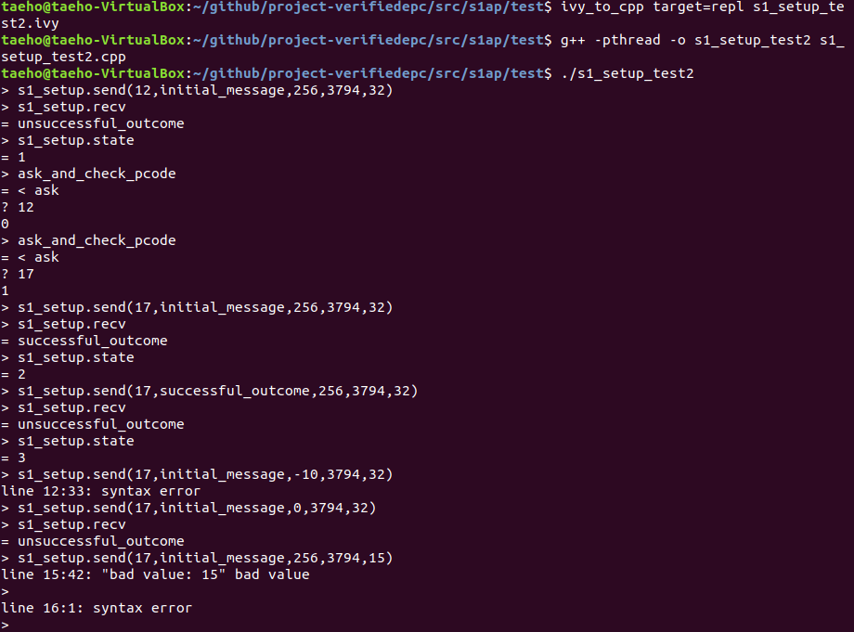
S1 Setup test execution

Slide 15
Conclusion
Current contributions:
Specified a simple manual testing scheme, using Ivy, that can:
Detect the correctness of the received response
Update simplified notion of state of the protocol
Specification of the protocol message-format in easily accessible formats: RFC and Apache Thrift
Main task remaining: 1. Specify protocol to enable automated test-generation 2. Develop shim, that interfaces the protocol-specification with network interface.

Slide 16
Goals
Prepare a formal specification of the protocol
Encode knowledge that’s implicit in implementations
Documentation: Keep track of updates introduced in newer versions of protocol
Execution: Automated extraction of test-generators and message-checkers
Test compliance to a common standard
Test in an adversarial environment
Function: Expose errors via testing
Make available the protocol message format specifications in a format that’s easily digestible by current web-technologies.
Obtain meaningful results from testing:
Test implementations to identify failure to conform/comply with the protocol-specification.
Identify bugs in implementations, or in the specification itself.
Identify system security vulnerabilities

